Slide 1
CA3 | Can-queror
Group 6
Virgil D’souza
Hans Delano
Faaris Jumadi
40% Mechanical, 40% Programming, 20% Electrical.

Slide 2
Background
Aluminium cans are used everywhere and it is the most recycled material but it is not recycled enough as people are find it inconvenient to out of their way to recycle and are too lazy.

Slide 3
Problem Statement:
How can we encourage people to recycle used cans?

Slide 4
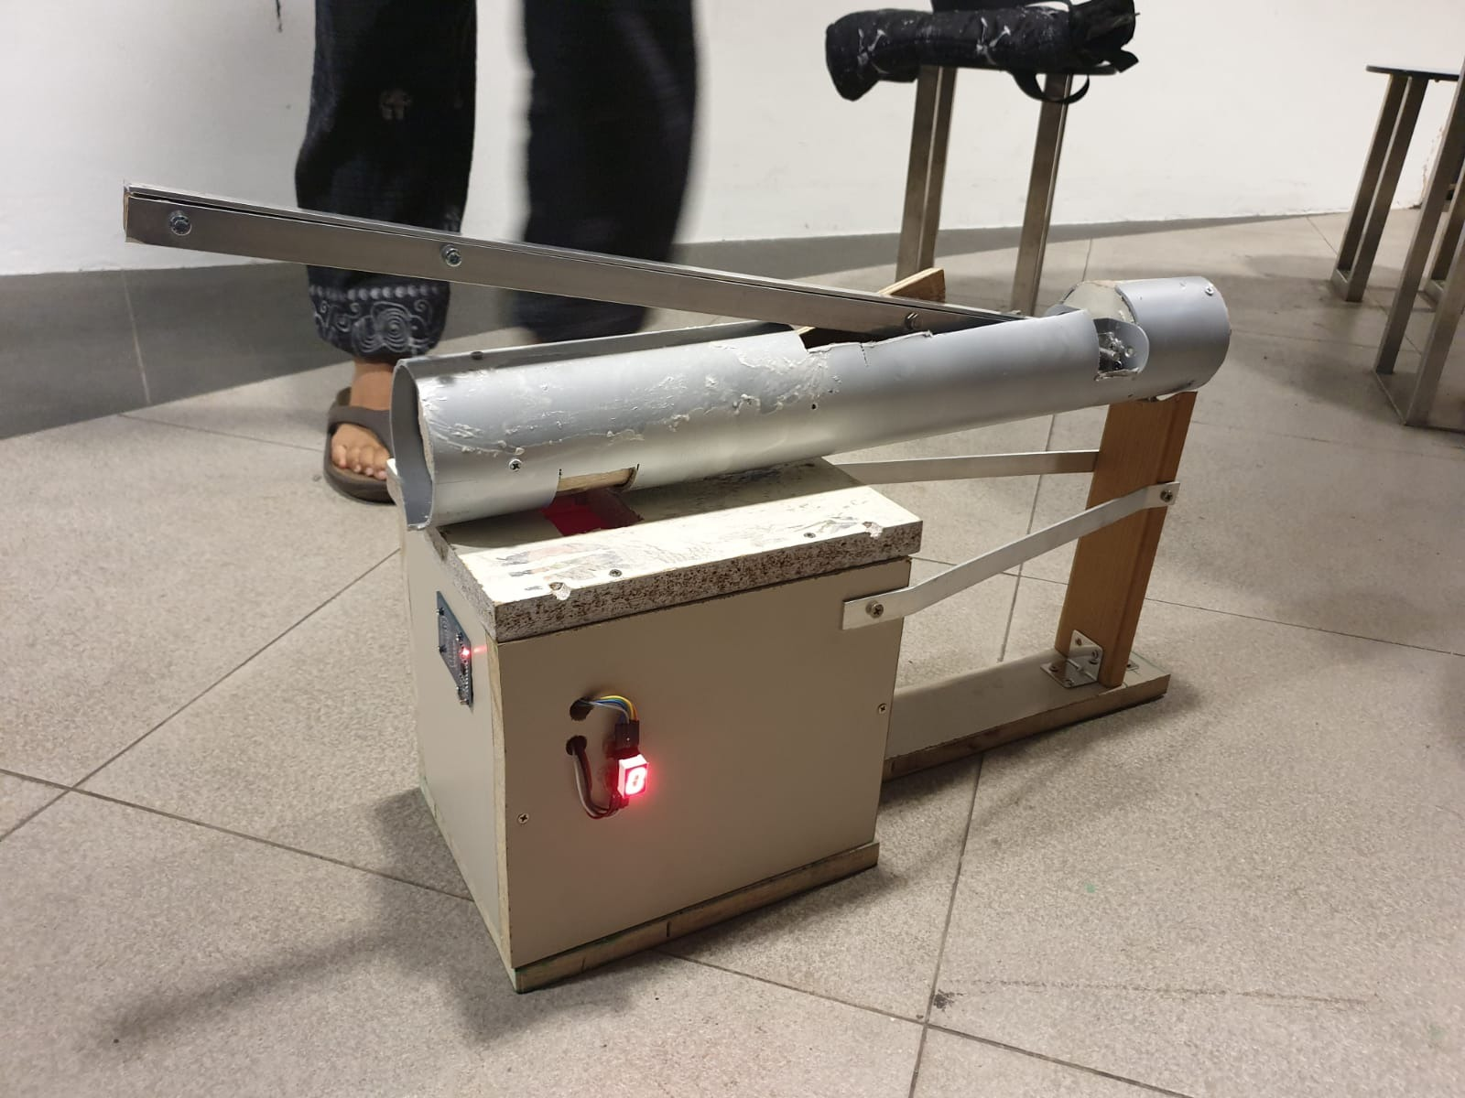
Solution
We decided to build a can-crushing machine that will reward users for recycling their aluminium cans. Based on the number of cans that the user put in, the user will have an amount of money debited into their ezlink card.

Slide 5
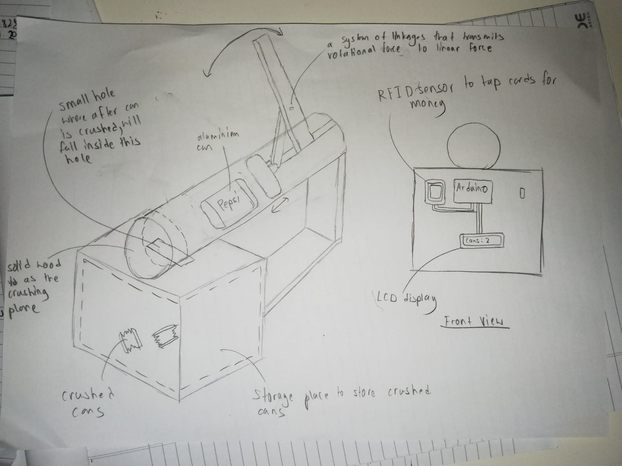
Concept Design

Slide 6
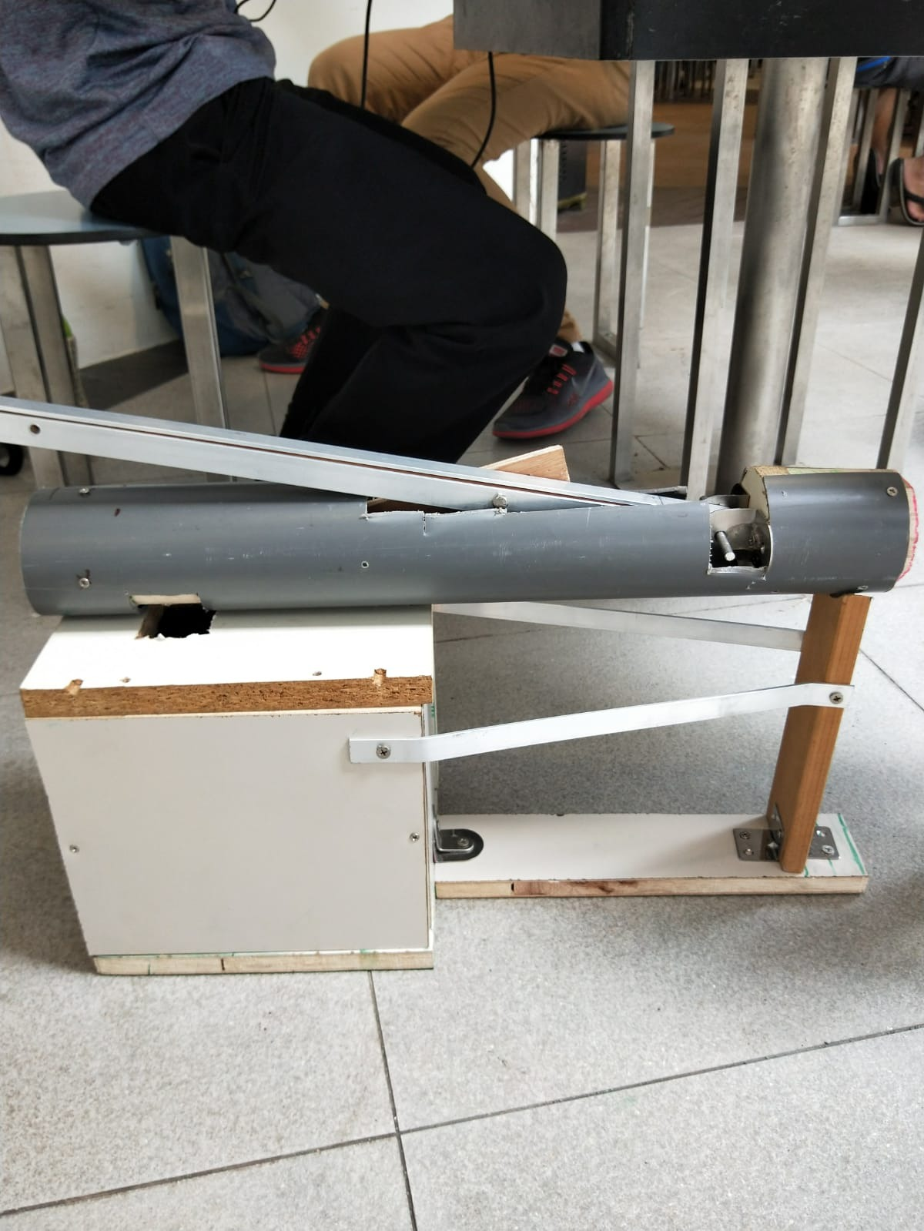
Product Chassis
Lever and shaft for can crusher
Box to contain cans that will be emptied when full.

Slide 7
Electronics
LED and light sensor - inside box to detect and count cans
7 segment display - to display number of cans and state of the machine
ESP32 - microcontroller with Wifi modularity
RFID - reads ezlink card and debits the accumulated money into the card, and microcontroller to read data from sensor
AWS - hosting the database and IoT integration

Slide 8
How it works
User begins by inserting a can into the chassis and crushing it manually using the crank
User inserts more cans
Once user is done, he taps on the RFID reader and an amount of money, based on how many cans he crushed, is debited into his ezlink card

Slide 9
Demo

Slide 10
Further Improvements
LCD display
Rewards system:
Leaderboard
Ezlink value debit
Get exclusive items(partnerships eg Gudetama)

Slide 11
Thank You - Q&A

Slide 12
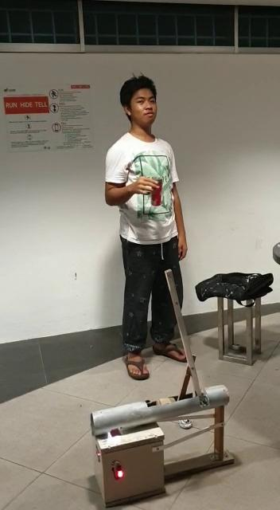
video

